Slide 1
Information Security
Week 04

Slide 2
MESSAGE AUTHENTICATION
A message, file, document, or other collection of data is said to be authentic :
when it is genuine and
came from its alleged source

Slide 3
Authentication Using Symmetric Encryption
Reordering & Sequence numbers
message encryption by itself does not provide a secure form of authentication

Slide 4
Message Authentication without Message Encryption
an authentication tag is generated and appended to each message for transmission
1- There are a number of applications in which the same message is broadcast to a number of destinations
2- one side has a heavy load and cannot afford the time to decrypt all incoming messages
3- Wasteful of processor resources

Slide 5
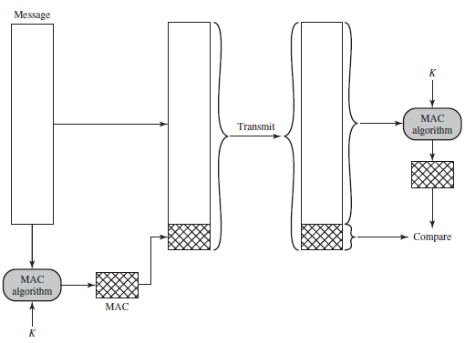
1- Message Authentication Code

Slide 6
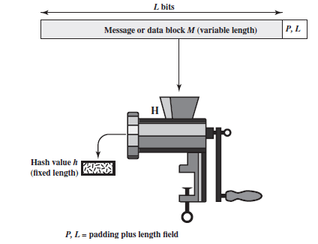
2- One-Way Hash Function
As with the message authentication code, a hash function accepts a variable-size message M as input and produces a fixed-size message digest H(M) as output.

Slide 7
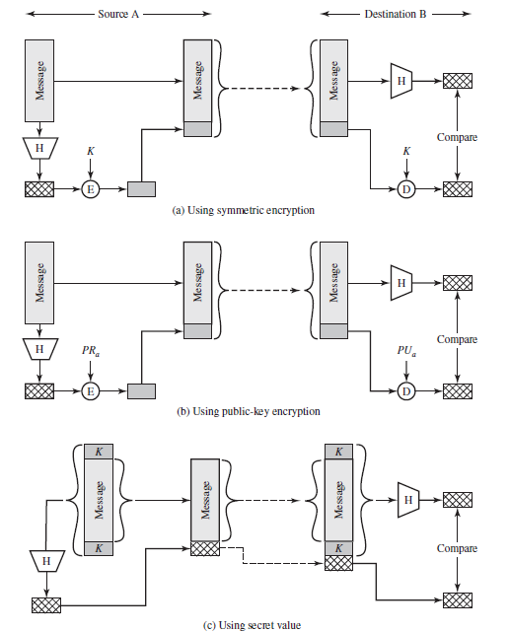

Slide 8
Advantage over Encryption
These two approaches have an advantage over approaches that encrypt the entire message, in that less computation is required.
Encryption software is quite slow.
Encryption hardware costs are non-negligible.
Encryption hardware is optimized toward large data sizes.
An encryption algorithm may be protected by a patent.

Slide 9
Hash Function Requirements
H can be applied to a block of data of any size.
H produces a fixed-length output
H(x) is relatively easy to compute for any given x, making both hardware and software implementations practical.
For any given code h, it is computationally infeasible to find x such that H(x) = h

Slide 10
Properties
Compression
For any given code h, it is computationally infeasible to find x such that H(x) = h. A hash function with this property is referred to as one-way or preimage resistant.
For any given block x, it is computationally infeasible to find y x with H(y) = H(x). A hash function with this property is referred to as second preimage resistant. This is sometimes referred to as weak collision resistant.
It is computationally infeasible to find any pair (x, y) such that H(x) = H(y). A hash function with this property is referred to as collision resistant. This is sometimes referred to as strong collision resistant.

Slide 11
public-key encryption
RSA Ron Rivest, Adi Shamir, and Len Adleman
Diffie–Hellman
Digital Signature Standard
Elliptic Curve Cryptography

Slide 12
Need for Public Key Encription
The secure distribution of public keys
The use of public-key encryption to distribute secret keys
The use of public-key encryption to create temporary keys for message encryption

Slide 13
Digital Signature
Public-key encryption can be used for authentication with a technique known as the digital signature
It provides a mechanism for verifying origin authentication, data integrity and signatory non-repudiation
Digital signature is a data-dependent bit pattern
Digital Signature Algorithm (DSA)
RSA Digital Signature Algorithm
Elliptic Curve Digital Signature Algorithm (ECDSA)

Slide 14
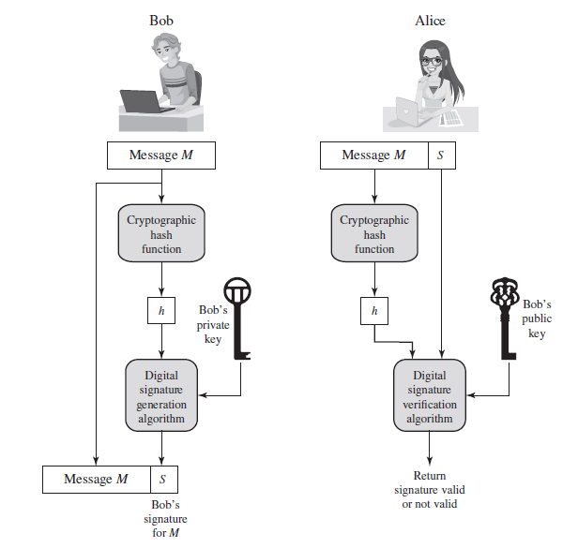

Slide 15
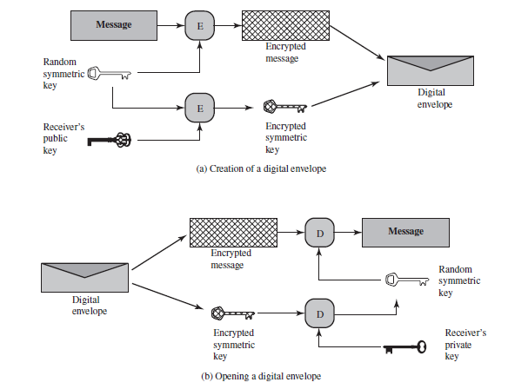
Digital Envelopes
Symmetric Key Exchange Using Public-Key Encryption

